Slide 1
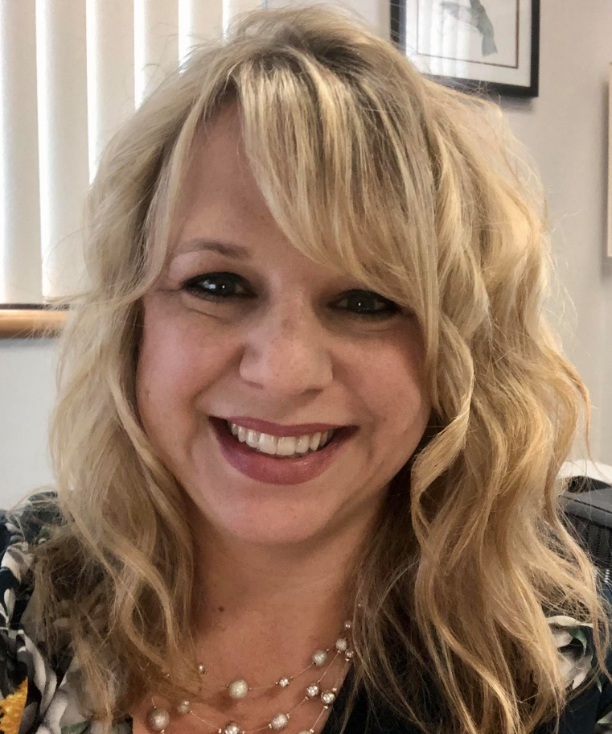
Interested in Expanding your Knowledge in
Clinical and Translational Science?
Translating Research
From Bench to Bedside
Lauren Aleksunes, PharmD, PhD
NJ ACTS Workforce Development Core Lead
Professor, Pharmacology and Toxicology
Rutgers University
Tuesday, September 21st
5 PM
On Zoom
Join us for an interactive session to learn about the various types of translational research. Most often we consider how new discoveries advance science from “bench to bedside”. However, it is also important to recognize how clinical observations inform subsequent research and move us from bedside to bench.
REGISTER HERE!
Registration is required. For additional details on how to join this webinar, send any questions and concerns to Yasheca Ebanks, NJ ACTS Project Manager at yebanks@shp.rutgers.edu.
Supported by the NJ ACTS grant UL1TR003017

